Slide 1
Fashion Sales Dashboard Analysis
Exploring Sales Trends Through Power BI

Slide 2
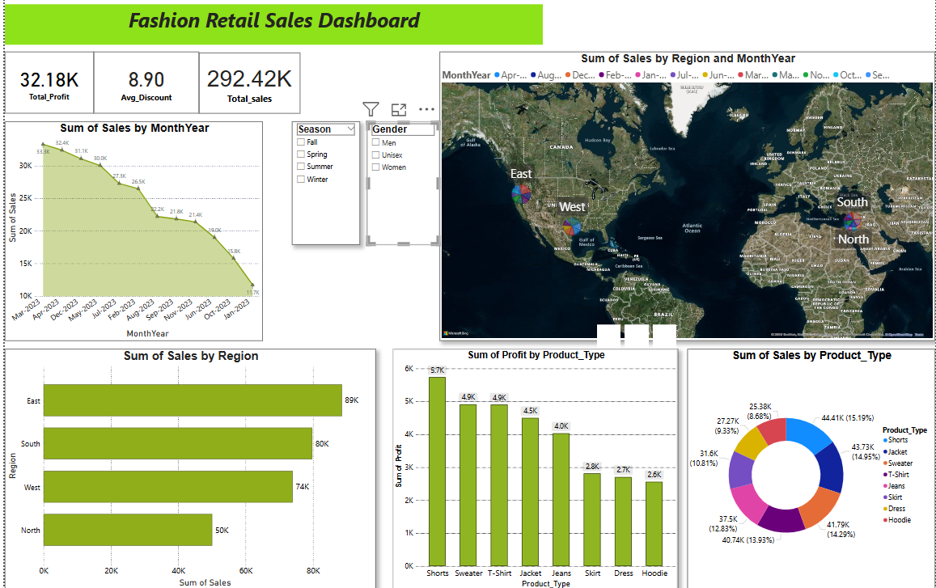
Fashion Sales Dashboard This interactive dashboard was designed using Power BI to analyze sales performance across different regions, product categories, and time periods.

Slide 3
Visuals in the Dashboard
1. Line Chart – Monthly Sales This line chart shows how sales changed from January to December.
Sales were highest in March (₹1,55,000).
There was a small drop in April, and it increased again in July.
2. Bar Chart – Sales by Region This bar chart shows which regions performed better.
North region sold the most, over ₹4,00,000.
East region sold the least, around ₹1,20,000.

Slide 4
3. Donut Chart – Sales by Product Category This chart shows which product types had more sales.
Clothing sold the most — nearly ₹3,75,000.
EAST region sold the least — less than ₹1,50,000.
4. Region Filter – Slicer There’s a filter where we can pick a region.
For example, choosing South will update all charts to show only that region’s sales.

Slide 5
Key Insights from Dashboard
Clothing category leads in sales Clothing category generated the highest sales overall, indicating strong demand across all regions.
North region performs best The North region consistently had the highest sales
Sales peak in March and July Line chart shows highest in these months, suggesting possible promotional campaigns or seasonal demand.
East region has lowest sales The East region underperforms, which may indicate a need to improve marketing or distribution there.

